Slide 1
CDS Evaluation Project Phase II
Overview

Slide 2
CDS Evaluation Project Phase II
Goal
Teach clinicians and field support staff a simplified evaluation process for assessing the impact of a Clinical Decision Support (CDS) intervention. At the end of the training, learners should be able to construct and execute a simple evaluation plan to assess both formative and summative aspects of a completed CDS intervention.
Intended Audience
Physicians, Nurses, Pharmacists, Psychologists, Social Workers
Non-clinical Informaticians
Other Field Support Staff

Slide 3
CDS Evaluation Project Phase II
Not Goals
General Human Factors
Human Centered Design Process
Complex Experimental Design
Statistically significant results
Cover all aspects of CDS

Slide 4
CDS Evaluation Project Phase II
Usage Scenario
Your clinic director has informed you that a new screening tool will be implemented to identify high-risk patients in your specialty. She has asked that you develop a simple evaluation plan to determine if the new tool will be a benefit for your clinic. High-risk patients are currently identified manually, by comparing a number of indicators to clinical guidelines. You are not expected to obtain statistically significant data. You are expected to provide feedback to the development team, formulate specific evaluation goals, determine an appropriate assessment method and to determine if performance will be improved by at least 10%. Because you are very busy, you want to learn a simplified process to complete your task.

Slide 5
Simplified Process
Initiate
Create Value Proposition
Obtain Intervention Description
Understand
Workflow
Tasks & Decisions
Plan Eval
Collect Data Using
Synthesize & Communicate
Roles
Environment of Use & Policies
Formulate Evaluation Goals/Objs
Determine Assessment Type
Heuristic Evaluation
Walkthrough using Think-Aloud
Usability Test
Process & Outcome Data (CDW)
Issue Severity & Frequency
Write Experimental Task/Scenario
Create/Obtain Test Patient Data
Common Reporting Format
Combining Findings & Recommend
System
Hard/Soft
Reporting Results
Apply the General Model

Slide 6
Information to Collect by Activity
Activity
Information

Slide 7
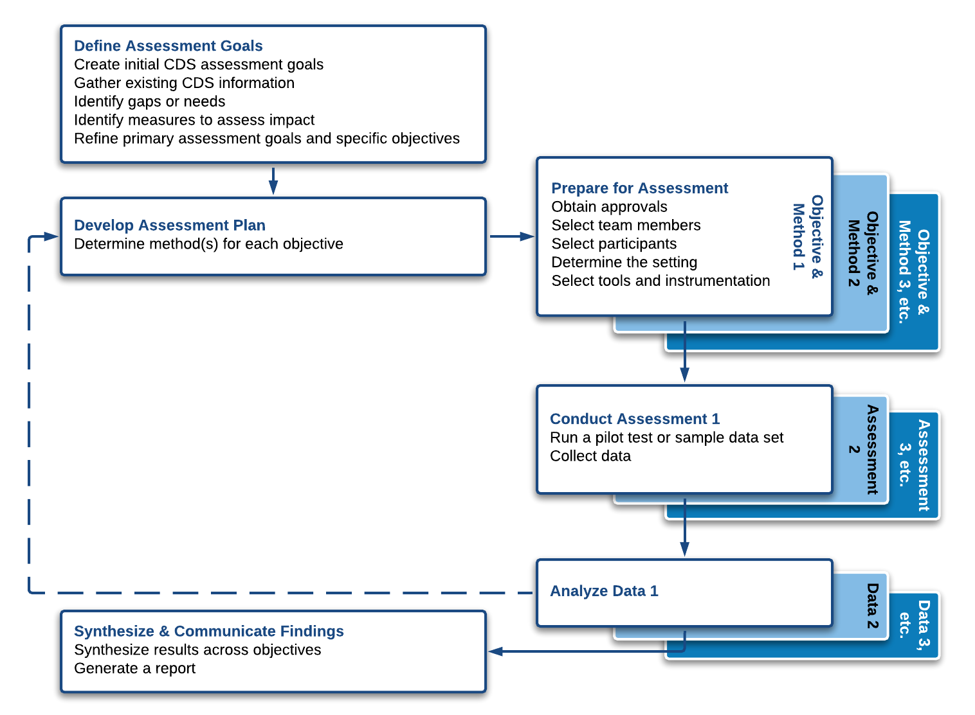
CDS Impact Evaluation Framework

Slide 8
Simplified Value Proposition
What’s the problem you’re trying to solve?
Who cares and why?
What is the current process?
What is the target process?
How will you measure success?

Slide 9
A General Model for CDS Evaluation
Measure Type | Effectiveness | Safety | Efficiency | Satisfaction
Right Information Presented to End User
Right Person to Receive Intervention
Right Time in the Workflow
Right Channel (Device) for Delivery
Right Intervention Format
Patient or Population Outcomes
Process or Organizational Outcomes

Slide 10
Questions
How can we simplify?
What doesn’t make sense?
What are the prerequisites?
What do learners need to understand for each section?
What’s missing?
What more do you want to know?

